Slide 1
Himanshu Nehra (31127)
BUS TICKET RESERVATION SYSTEM

Slide 2
Bus Ticket Reservation Service
It is a web-based application designed to simplify the process of booking bus tickets. It allows Users to search for available buses, view schedules and make reservations online. The system is built with a user-friendly interface to ensure smooth navigation for both Users and administrators.

Slide 3
Key features include:
User Login – Secure authentication for passengers .
Search & Filter – Passengers can search buses by routes .
User Dashboard – Search buses and book their routes.
Admin Dashboard – Manage buses, routes and schedules.
Database Management – Efficient use of SQLite to store passenger details, reservations, and schedules.

Slide 4
Aims:
This project aims to replace the traditional manual booking process with an efficient digital system that saves time, reduces errors, and enhances passenger convenience. It can be further expanded to include features such as mobile app support, e-ticket generation, and real-time bus tracking.

Slide 5
Architecture Used – Microservices Architecture
Instead of building bus ticket system as one big application (monolith), we divide it into small independent services, each handling a specific functionality.
Services:
Userlogin Service → handles login, profiles
BusSchedule Service → manages routes & schedules
Reservation Service → ticket booking

Slide 6
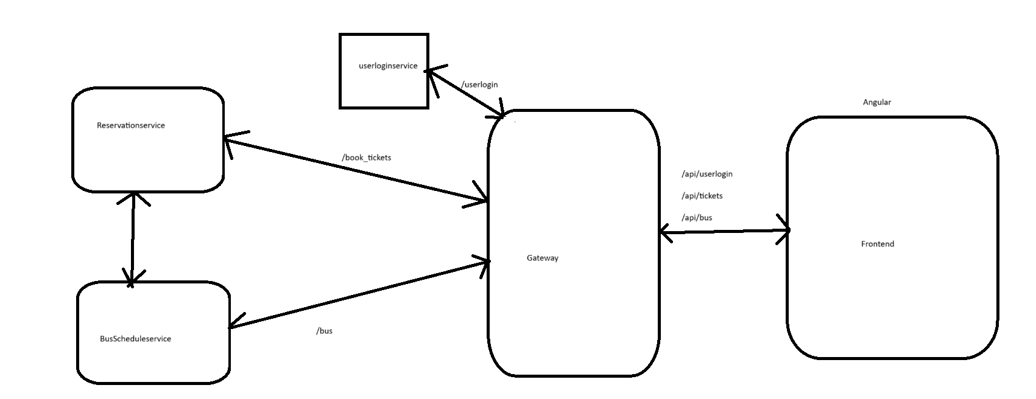
Architecture Diagram

Slide 7
1. User Service
Overview: Handles passenger , login and authentication.
APIs Exposed:
POST /userlogin → Register new user
GET /userlogin → Get user Credentials

Slide 8
2. BusScheduleService
🔹 Overview: Manages bus routes, schedules, and available buses.
🔹 APIs Exposed:
GET /bus → Get all buses
GET /bus/{bus_id} → Get Bus details
POST /bus → Add new bus (admin only)
PUT /bus/{bus_id} → Update bus details

Slide 9
3. Reservation Service
🔹 Overview: Ticket booking, cancellations, and Booking history.
🔹 APIs Exposed:
POST /book_tickets → Create a new booking (seat reservation)
GET /book_tickets/{ticket_id} → Get booking details by booking ID
DELETE /book_tickets/{ticket_id} → Cancel a booking

Slide 10
4. Containerization – Containers Created
Containers Created in the Bus Ticket Reservation System
Userlogin Service Container
Busschedule Service Container
Reservation Service Container
Gateway Service Container
Frontend Service Container

Slide 11
Deployment – Docker Compose
Deployment of the Bus Ticket Reservation System is done using Docker Compose.
Each microservice, API Gateway, and frontend runs inside its own Docker container.
Docker Compose is used to manage all containers together.
With a single command docker-compose up, the entire system is deployed.

